Slide 1
Deep Dive in Mean..
Weighted Mean
Examples

Slide 2

Weighted Mean
Weighted mean is calculated by multiplying each data values by a weight and dividing their sum by the sum of weights.
$$xw=\frac{\sum_{i=1}^{n}{wixi} }{\sum_{i}^{n}{wi} }$$

Slide 3
Pros….
Reflects Importance: The weighted mean provides a more accurate representation of the dataset when certain values are more important or significant than others. It allows for nuanced analysis by giving more influence to values with higher weights.
Flexibility: It offers flexibility in data analysis by allowing analysts to incorporate subjective judgments or external factors into their calculations. This is particularly useful in scenarios where certain data points carry more weight due to their relevance or impact.
Precision: In situations where different values have varying degrees of relevance, the weighted mean can provide a more precise estimate of central tendency compared to the unweighted mean.

Slide 4
Limitations
Subjectivity: Determining appropriate weights can be subjective and may vary depending on the context or analyst's interpretation. This subjectivity can introduce bias and affect the reliability of the results.
Complexity: Calculating the weighted mean requires additional effort compared to the unweighted mean, especially when dealing with large datasets or when weights need to be adjusted frequently.
Sensitivity to Outliers: Like other measures of central tendency, the weighted mean can be sensitive to outliers. Extreme values with disproportionately high weights can significantly influence the calculated mean, potentially skewing the results

Slide 5
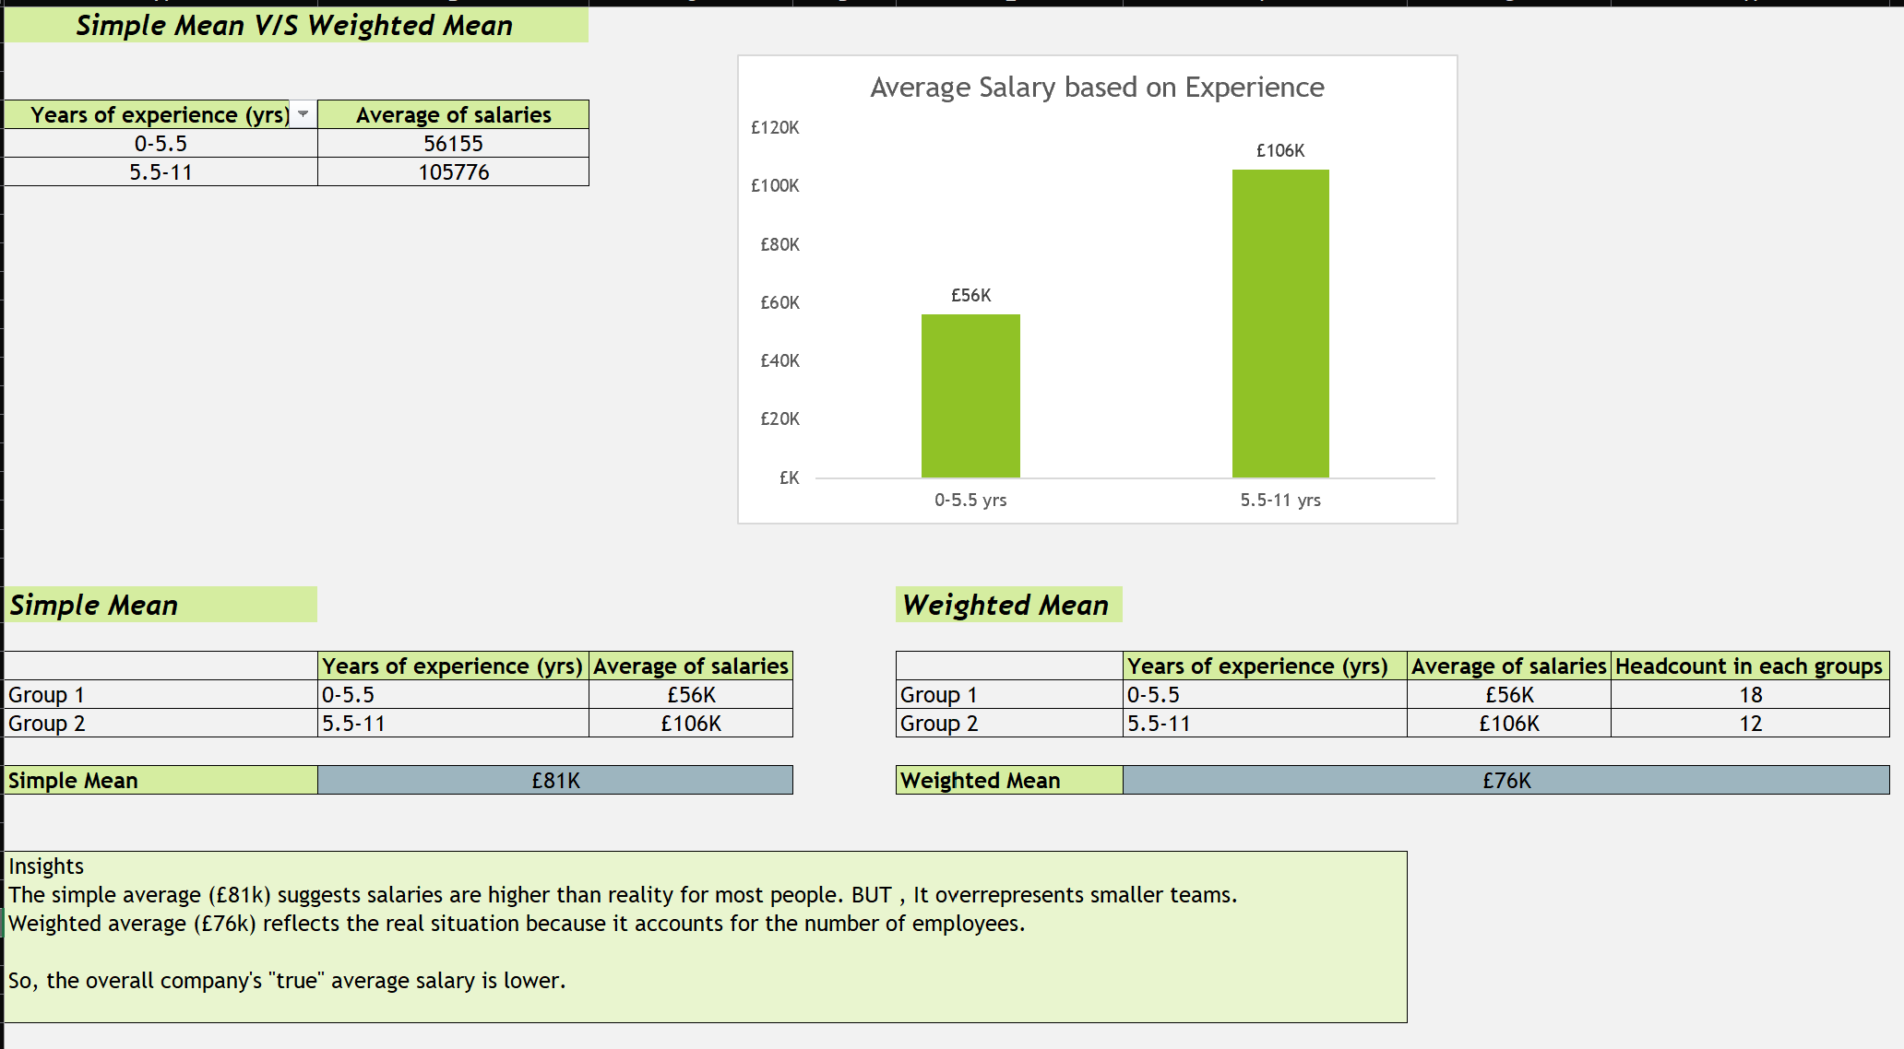
Problem Statement- Significance of weighted averages in salary analysis
Comparing the simple mean (unweighted) and weighted mean can help show how much bias or error the simple mean introduces when weights (like different team sizes) are important.
If the simple mean and weighted mean are very different, it shows that the simple mean would give misleading insights.
Check out my excel analysis

Slide 6
Summary
The weighted mean is a statistical measure of central tendency that takes into account the importance or significance of each value in a dataset by assigning weights to them.
To understand better, check out example in excel sheet

